Slide 1

GROUP SEVEN (7)
01
06
GODSWILL OWUSU ACHEAMPONG - 1812722
WALKER, KWESI - 1829422
02
07
DARKO KWEKU AGYEMANG - 1821222
BOISON, SIMEON - 1820222
03
KOBINA ANSU AGYEI KYEREMEH - 1823722
08
MICHAEL ABBEY - 1812222
04
ALHASSAN SALIFU BABAMU- 1815822
09
REGINALD ASUAKO - 1818722
05
10
KORAY COLIN OWURAKU - 1823422
CYRILLE CARLIN SARPEI - 1828022

Slide 2
TABLE OF CONTENTS
01
04
PROBLEM STATEMENT
CONCLUSION
02
METHODOLOGY
03
DEMONSTRATION

Slide 3

IOT BASED AIR QUALITY MONITOR
GROUP SEVEN (7)

Slide 4


PROBLEM STATEMENT

Slide 5

01
WHY IS THIS PROJECT IMPORTANT?
Air pollution is a major health concern, and monitoring air quality helps in taking preventive measures.
Traditional air monitoring systems are expensive and not easily accessible.
This project aims to develop a cost-effective IoT-based air quality monitoring system.

Slide 6

02
KEY OBJECTIVES
Measure air quality using an MQ-2 gas sensor.
Display readings on an OLED screen.
Use an LED indicator to signal high pollution levels.
Monitor temperature & humidity with a DHT22 sensor.

Slide 7


METHODOLOGY

Slide 8

METHODOLOGY
01
The approach involved researching air quality monitoring needs, selecting suitable sensors (MQ-2 for gas, DHT22 for temperature/humidity), and designing a system with an Arduino microcontroller. The hardware was integrated with an OLED display for real-time visualization and an LED for alerts. Finally, the system was tested, optimized, and deployed to ensure accurate and reliable air quality monitoring.

Slide 9

02
CORE COMPONENTS
MQ-2 Gas Sensor (simulates CO₂ and PM2.5 levels)
DHT22 (measures temperature and humidity)
SSD1306 OLED Display (128×64, I2C) for real-time readings
LED Indicator (on D7) for visual alerts
Serial Monitor (debugging/logging)
Arduino Uno R3 (Microcontroller)
Resistors and Breadboard

Slide 10
03
SOFTWARES
Wokwi Online Simulator (https://wokwi.com)
KiCad
Adafruit SSD1306 & DHT Libraries

Slide 11
04
KEY FUNCTIONALITY
Gas Detection
The MQ-2 detects gases like (CO₂(ppm) and PM2.5 (µg/m³))
The values from these gases are read from the MQ-2 (A0 pin) for simulation:
The LED is triggered, then it blinks (3x) if the gas exceeds it’s threshold of (340).

Slide 12
05
KEY FUNCTIONALITY
Environmental Sensing
The DHT22 sensor measures humidity (%) and temperature (°C).
When errors occur in the sensor the OLED gracefully displays "Err".

Slide 13
06
KEY FUNCTIONALITY
User Feedback
LED Alerts:
The LED blinks 3x to show that a High gas detected.
The LED blinks 2x to show that there is a DHT22 sensor error.
The LED remains steady (ON) to show that the operation is Normal.

Slide 14
07
KEY FUNCTIONALITY
OLED Display:
The OLED displays the following; CO₂ (ppm), PM2.5 (µg/m³), Humidity (%) and Temperature (°C)
Air quality is categorized into 4 levels (Normal, Poor, Bad, Toxic) based on MQ-2 sensor readings. The thresholds are set at 340, 400, and 700.
The system updates every 2 seconds, providing real-time feedback while ensuring display readability.
Serial Output:
The sensor data or values are logged to serial for debugging

Slide 15

CODE SUMMARY
The IoT-Based Air Quality Monitoring System provides real-time air quality monitoring using an MQ-2 gas sensor for gas detection and a DHT22 sensor for temperature and humidity measurement. An OLED display shows real-time data, while an LED indicator provides alerts based on gas levels and sensor errors. The setup function initializes the sensors, display, and Serial Monitor, ensuring proper configuration. The OLED screen, controlled via the Adafruit SSD1306 library, displays an initialization message, and the LED turns on to indicate system readiness. In the loop function, sensor readings are continuously processed, and if gas levels exceed 300, the LED blinks three times, signaling a warning. If the DHT22 sensor fails, the LED blinks two times, indicating an error.

Slide 16
CODE SUMMARY
The OLED display updates with CO2, PM2.5, temperature, and humidity readings, categorizing air quality as "Normal," "Poor," "Bad," or "Toxic" based on MQ-2 values. Sensor data is also sent to the Serial Monitor for debugging and analysis, with updates occurring every two seconds. A helper function, blinkLED, manages LED blinking for alerts. This system is a cost-effective and efficient solution for IoT applications and home automation. It enhances air quality awareness by providing real-time environmental data. With its reliable design, it can be expanded for smart home automation and environmental research. This makes it a valuable tool for monitoring indoor and outdoor air quality.

Slide 17
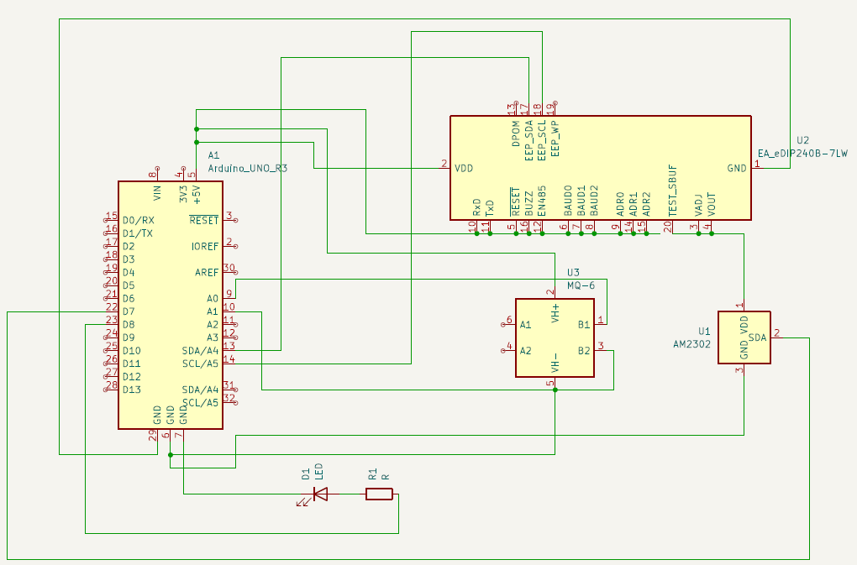
SCHEMATIC DIAGRAM

Slide 18
SCHEMATICS
COMPONENT
PIN ON COMPONENT
ARDUINO PIN
Power Connections | VDD (5V) | 5V
 | GND | GND
EA eDIP240B-7LW (U2) (I²C Display) | SDA | A4 (SDA)
 | SCL | A5 (SCL)
 | VDD | 5V
 | GND | GND

Slide 19
SCHEMATICS
COMPONENT
PIN ON COMPONENT
ARDUINO PIN
MQ-6 Gas Sensor (U3) | VH+ | 5V
 | VH- | GND
 | B1 | A0
 | B2 | A1
MQ-6 Gas Sensor (U3) | VH+ | 5V
 | VH- | GND

Slide 20
SCHEMATICS
COMPONENT
PIN ON COMPONENT
ARDUINO PIN
DHT22 Temperature & Humidity Sensor (U1) | VDD | 5V
 | GND | GND
 | DATA | D7
LED (D1) | Anode (+) | Resistor (R1) → D8
 | Cathode (-) | GND
Resistor (R1) (Connected to LED) | One side | D8
 | Other side | LED Anode (+)

Slide 21

DEMONSTRATION

Slide 22
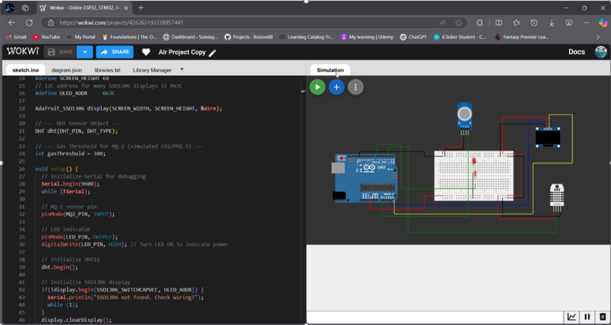
SIMULATION
YOR NAE
YOUR NAME

Slide 23

CONCLUSION

Slide 24
FINDINGS
01
The IoT-Based Air Quality Monitoring System successfully provides real-time environmental monitoring using an MQ-2 gas sensor, DHT22 sensor, and an OLED display. The system effectively detects gas concentrations, temperature, and humidity while offering visual alerts through an LED indicator. By categorizing air quality as "Normal," "Poor," "Bad," or "Toxic," it enables users to assess environmental conditions easily. The integration of Serial Monitor logging ensures continuous data tracking for analysis. The system demonstrates high reliability and cost-effectiveness, making it a valuable tool for indoor and outdoor air quality awareness.

Slide 25
CHALLENGES
02
During development, some challenges were encountered, such as sensor calibration issues, fluctuating readings, and OLED display integration difficulties. Also ensuring accurate air quality thresholds required for extensive testing.

Slide 26
03
FUTURE IMPROVEMENTS
To improve the system, enhanced calibration techniques could be applied for more precise readings. Additionally, Wi-Fi or Bluetooth connectivity could be integrated to allow remote monitoring via a mobile app or cloud storage. Future improvements may include adding more sensors for detecting specific pollutants and implementing a mobile notification system for real-time alerts. These enhancements would make the system even more versatile and effective in air quality management.

Slide 27

THANK YOU!

